Slide 1

Does the car you drive affect Air Quality?
Se7en
Celeste Muniz-Lithgow
Deepa Vadakan
Palak Soni
Tim Samson

Slide 2

Air Quality
Millions of people live in areas where air pollution can cause serious health problems. Local air quality can affect our daily lives. Like the weather, it can change from day to day. EPA developed the Air Quality Index, or AQI, to make information available about the health effects of the five most common air pollutants, and how to avoid those effects.
Ozone and particulate matter from vehicles are two source of these pollutants.
https://www.airnow.gov/aqi/

Slide 3
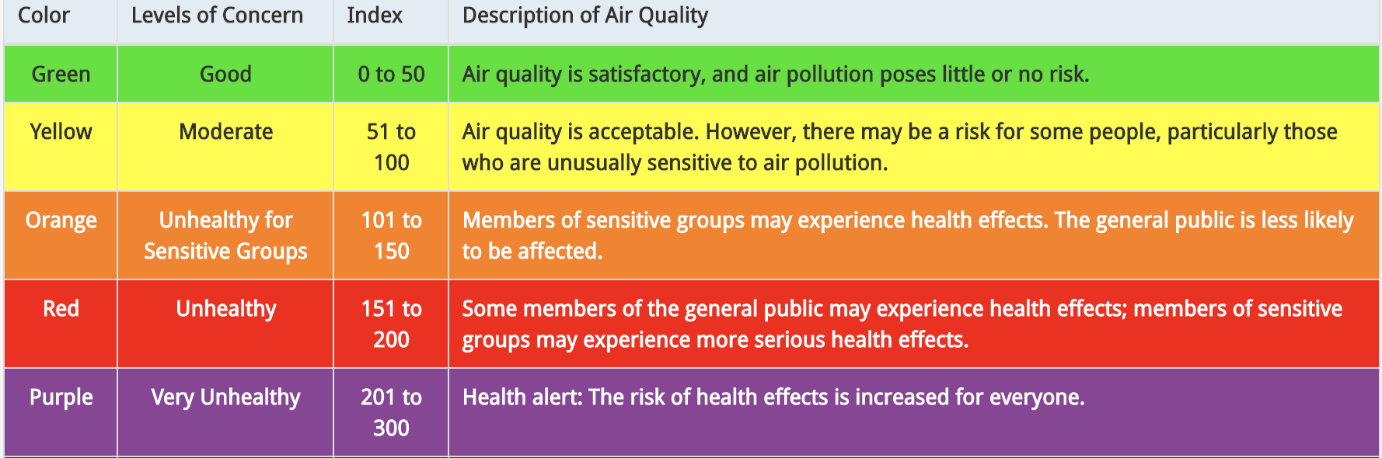
Air Quality Index
Think of the AQI as a yardstick that runs from 0 to 500. The higher the AQI value, the greater the level of air pollution and the greater the health concern. For example, an AQI value of 50 or below represents good air quality, while an AQI value over 300 represents hazardous air quality.
https://www.airnow.gov/aqi/

Slide 4
Hypothesis: There is a correlation between vehicles and the air we breathe.
Questions
Does the density of cars in a particular area affect air quality?
Does the age of cars affect air quality?
Does the type of car affect air quality?
Is a hybrid/electric car more beneficial to our health?

Slide 5



Source
Vehicle, Snowmobile, and Boat Registrations from data.ny.gov
AQI Index from airnowapi.org
Zip code coordinates from Public.Opendatasoft.com

Slide 6
Challenges
Huge size of the vehicle data from data.ny.gov. Over 11 million records.
Limits on the API call to retrieve Air Quality Index from AirNow. Limit of 500 requests per hour.
Air Quality Index not available on AirNow prior to 2009.
We limited ourselves to 3 years worth of Air Quality Index data: 2009, 2015 and 2020.

Slide 7
Data Cleanup & Exploration
NY Vehicle data retrieval and cleanup
https://github.com/paloni-dotcom/Se7en/blob/main/ny_vehicle_data.ipynb
Air Quality Index retrieval and cleanup
https://github.com/paloni-dotcom/Se7en/blob/main/air_quality_index.ipynb

Slide 8

Data Analysis

Slide 9
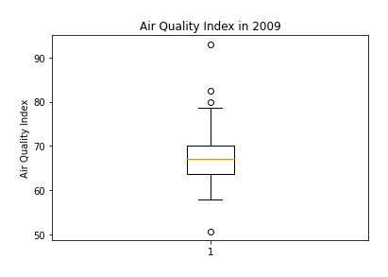
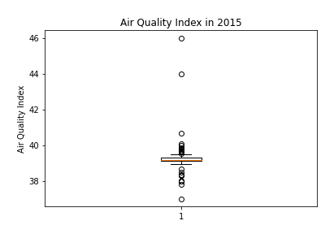
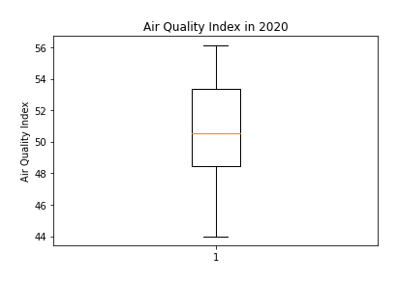
Comparing Air Quality Index for 2009, 2015 and 2020
The Air Quality Index in 2009 was an average of 68 with a few outliers.
2015 had an average Air Quality Index of 39 which is a significant drop. However, this year had many outliers.
In 2020, the average Air Quality Index was around 50 which is an increase from 2015 and decrease from 2019.
Overall, the Air Quality has improved from 2009 to 2020.

Slide 10
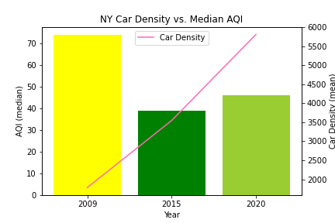
New York Car Density vs. Median AQI
Here we are comparing the Median Air Quality Index for 2009, 2015 and 2020 to car density.
The colors of each bar correspond to Air Quality Index color gradient. Yellow = Moderate, Green = Good.
Once again, we see that increased car density over the last decade has no affect on AQI.

Slide 11
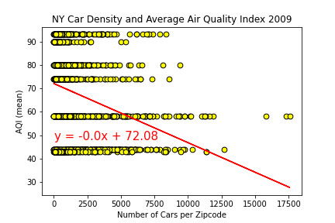
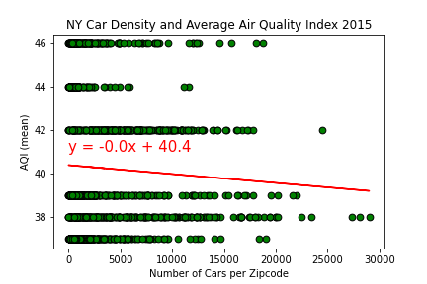
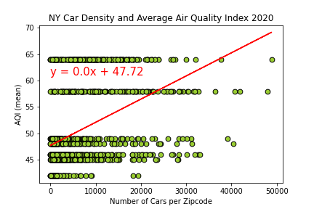
Does the density of cars in a particular area affect air quality?
Here we are comparing the Air Quality Index based on density of cars by zipcode.
The following scatter plots for years 2009, 2015 and 2020 show that density of cars in a given area does not have a correlation to the average Air Quality Index.
NY Car Density and Average Air Quality Index 2009, 2015 and 2020
R-value: 0.0955
R-value: 0.0033
R-value: 0.1801

Slide 12
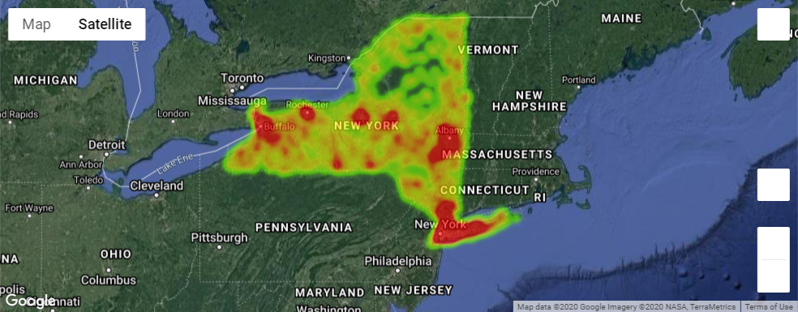
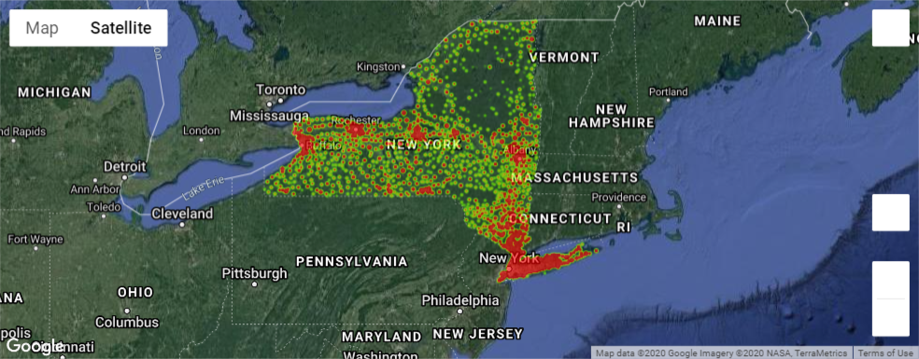
Comparing Air Quality Index and Number of Cars for 2009
AQI
Total Cars

Slide 13
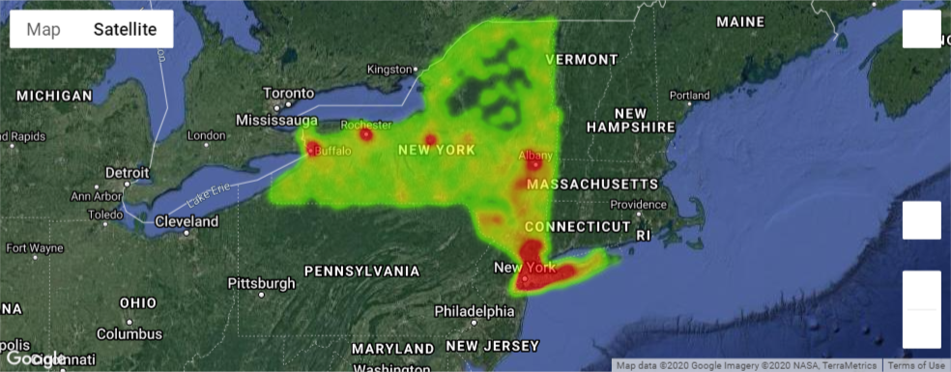
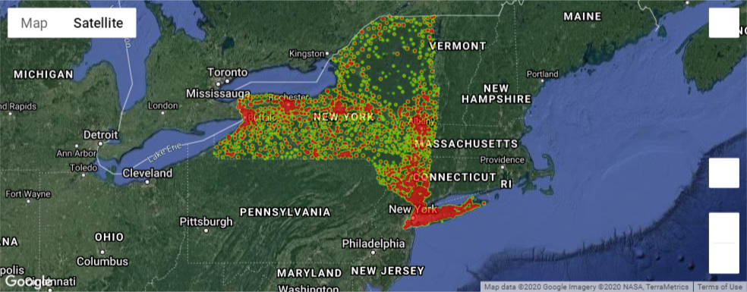
Comparing Air Quality Index and Number of Cars for 2015
AQI
Total Cars

Slide 14
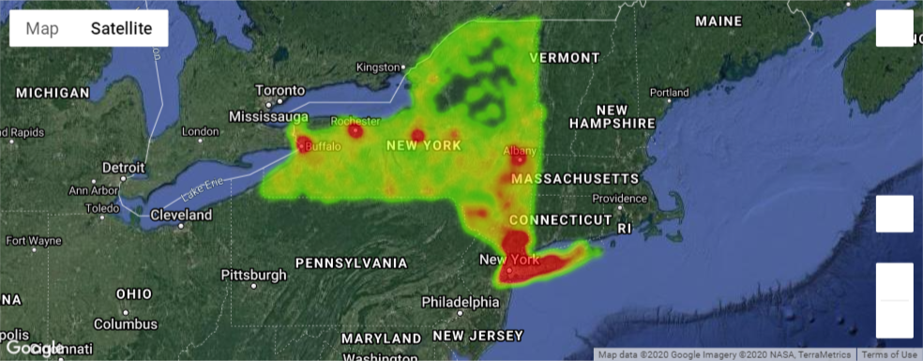
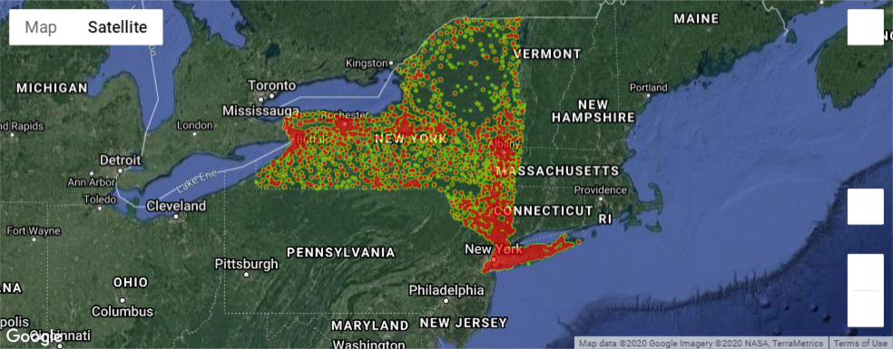
Comparing Air Quality Index and Number of Cars for 2020
AQI
Car Age
Total Cars
2020

Slide 15
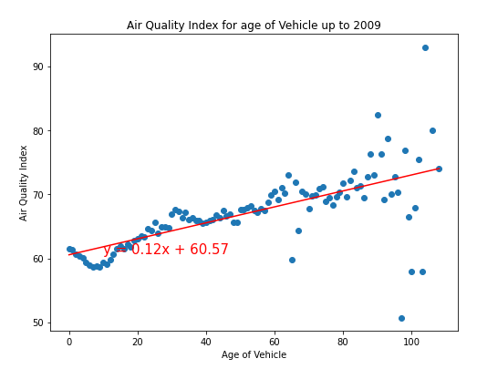
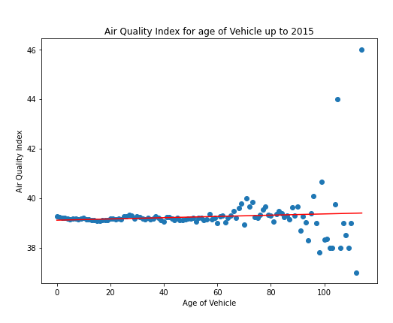
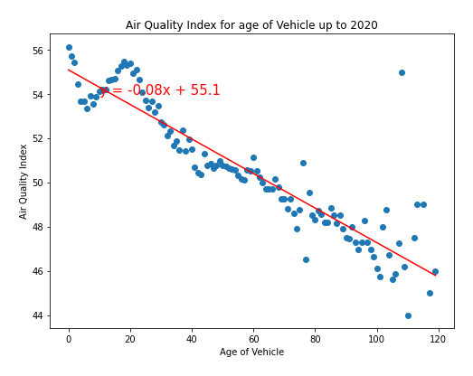
Air quality Index vs Age of Vehicles for 2009, 2015 and 2020
Here we are comparing the Air Quality Index based on the age of the cars by zipcode.
In 2009, the scatter plot shows that the Air Quality was better in areas with newer cars than with older cars.
In 2015, the scatter plot does not show much difference in the air quality index. Though, there was a wide range of Air Quality Index values for older cars.
In 2020, the Air Quality Index dropped for areas that have older cars. This may be because they are not in use as much or these cars are slowly being phased out.
R-value: .45
R-value: .06
R-value: .075

Slide 16
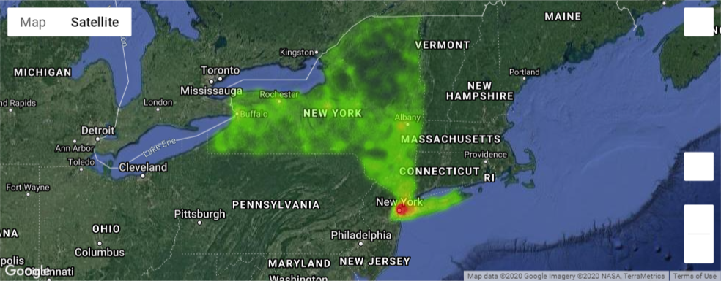
Comparing Air Quality Index and Car Age for 2009
AQI
Car Age

Slide 17
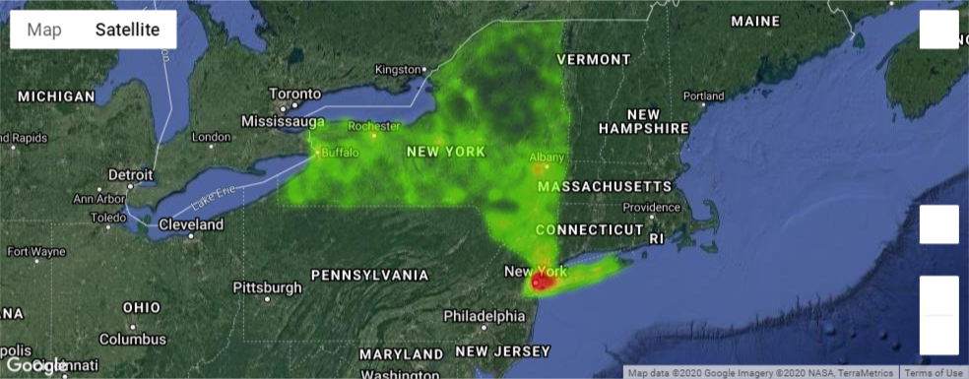
Comparing Air Quality Index and Car Age for 2015
AQI
Car Age

Slide 18
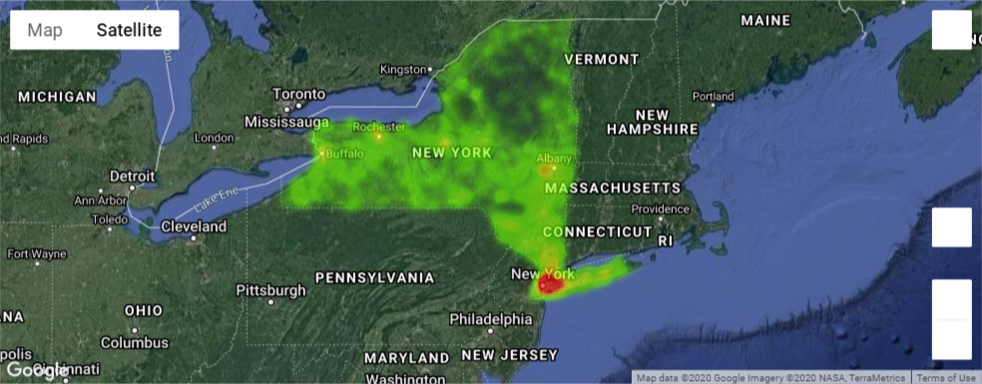
Comparing Air Quality Index and Car Age for 2020
AQI
Car Age
2020

Slide 19
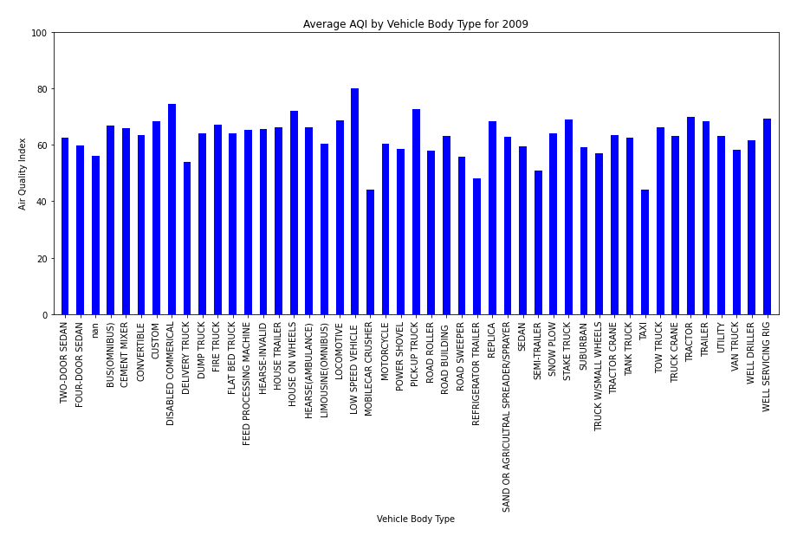
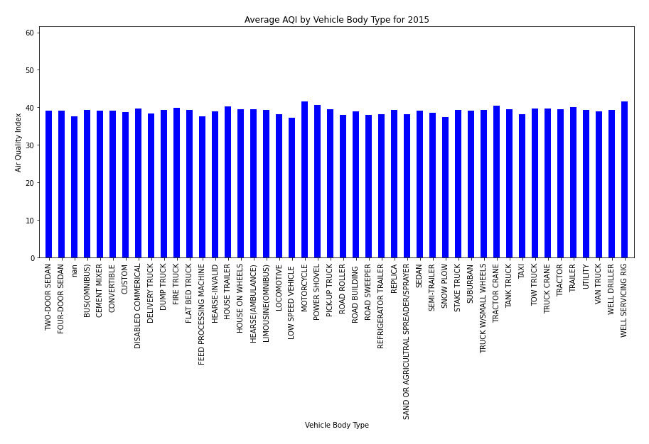
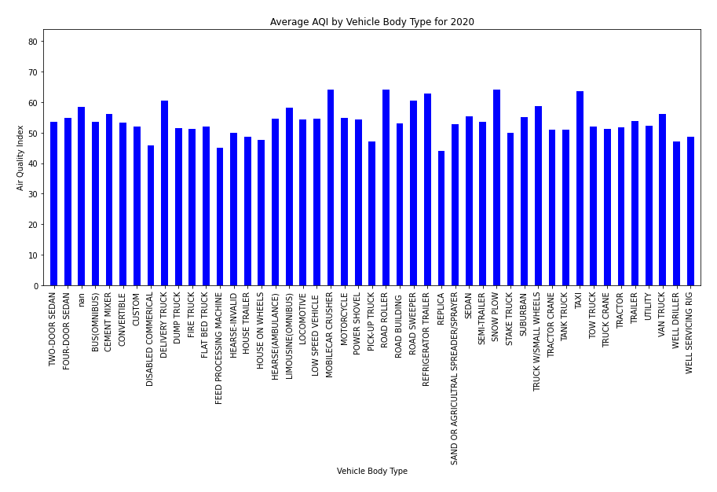
Air Quality Index per Body Type for 2009, 2015 and 2020
There does not seem to be any difference in the type of car and the Air Quality.

Slide 20
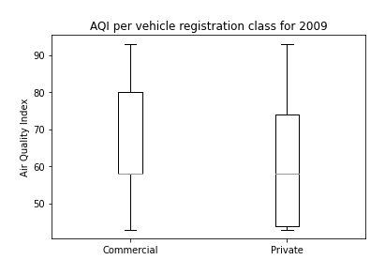
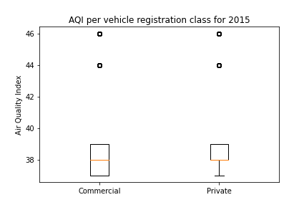
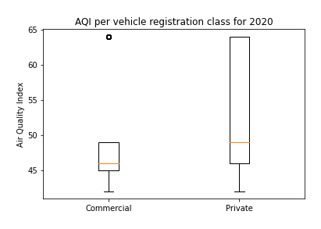
Air Quality Index for Private vs Commercial cars
In 2009, areas with more commercial vehicles had a higher Air Quality Index which means poorer air quality.
In 2015, the air quality between commercial and private vehicles was almost the same.
In 2020, the air quality in areas with private vehicles was more than those with commercial vehicles.

Slide 21
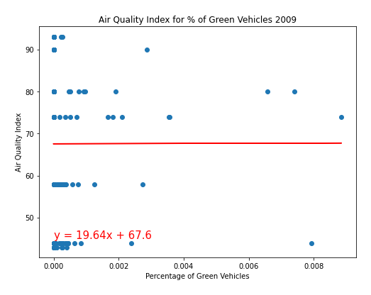
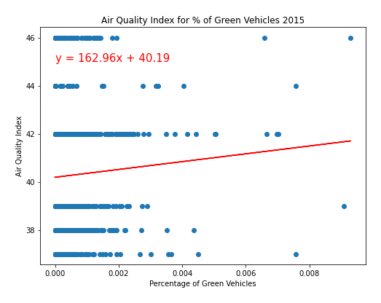
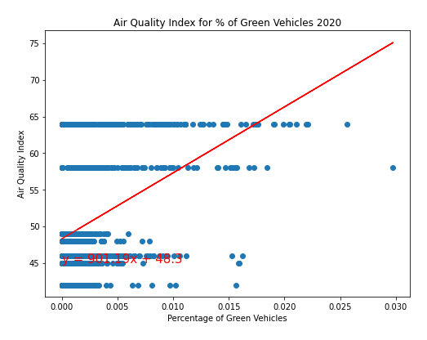
Air Quality Index vs. ”Green” Electric/Hybrid Vehicles.
Given the low r- squared values:
2009 - 2.2896326595606945e-07
2015 - 0.0018160267526019039
2020 - 0.16217576809651804
There is no Correlation between AQI index and the number of “Green” vehicles in a zip code area.

Slide 22
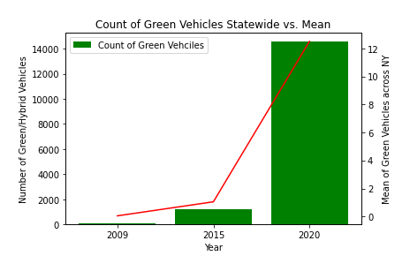
Comparison of ”Green” Vehicle Counts and NY Statewide Mean
Using our 3 datasets it is evident that both the number of “Green” vehicles in the state and the mean (average numbers of green vehicles per zip code within the state) have increased dramatically.
Green Vehicles ownership
From a low of 70 statewide in 2009 to 14,455 in 2020
Mean has increased from .04 to 12.51

Slide 23
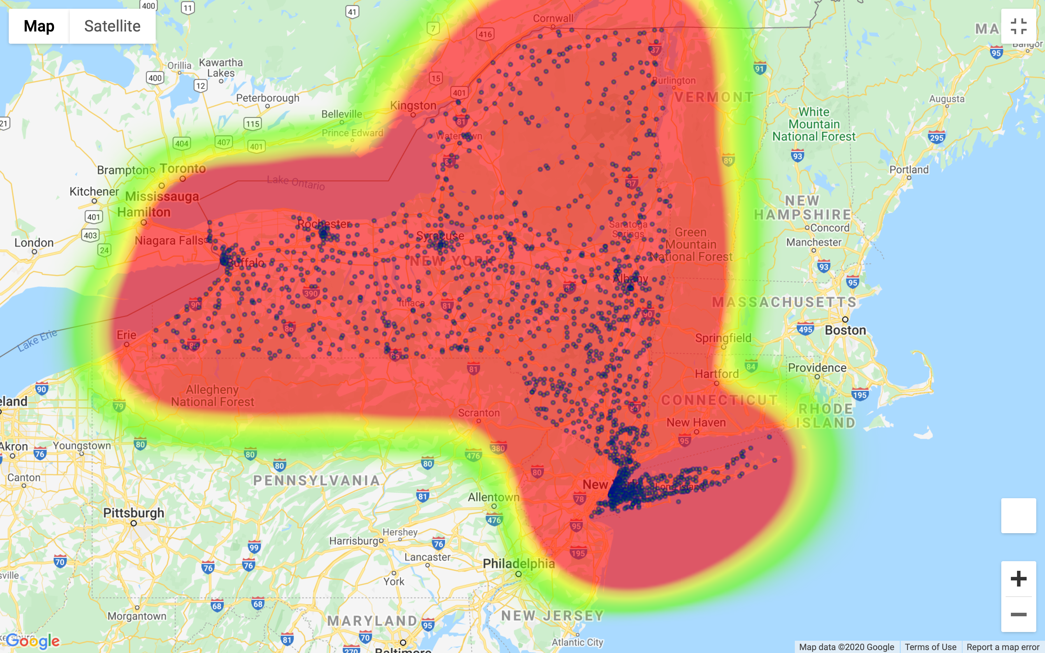
Distribution of ”Green” vehicles in relation to AQI 2009
Vehicle density of “Green” vehicles is greatest in Urban areas vs. rural.
Ownership if “Green” vehicles appears to have little impact on AQI

Slide 24
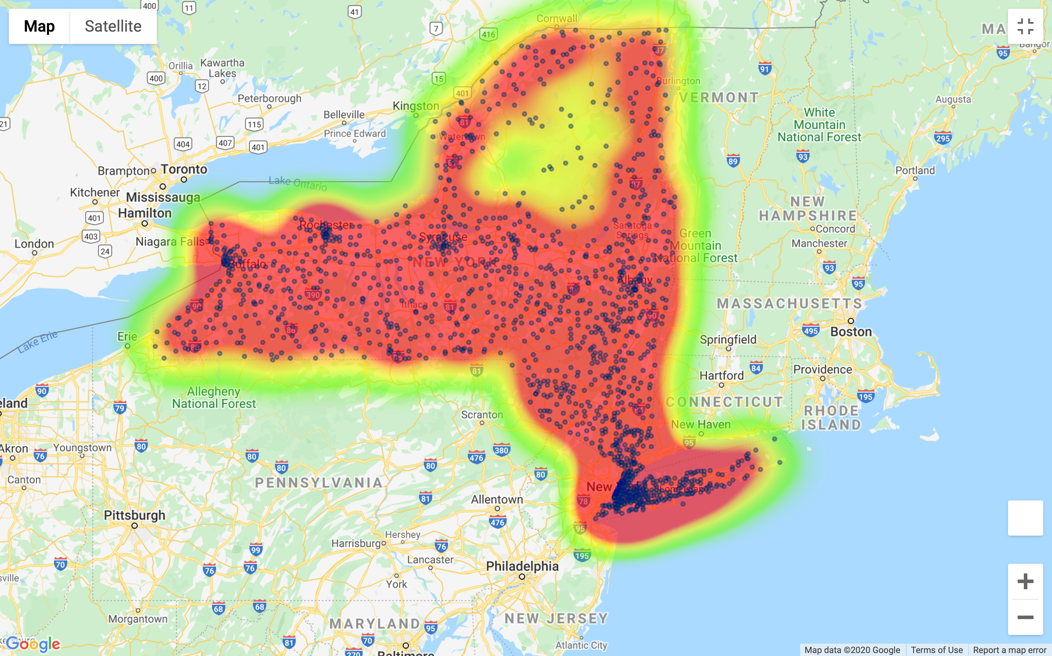
Distribution of ”Green” vehicles in relation to AQI 2015
Vehicle density of “Green” vehicles continues to be greatest in Urban areas vs. rural.
Ownership if “Green” vehicles appears to have little impact on AQI
AQI appears to be getting better.
Larger indicators for vehicle locations indicate larger number of vehicles in that zip.
We see an increase in number of total “Green” vehicles overall in the state.

Slide 25
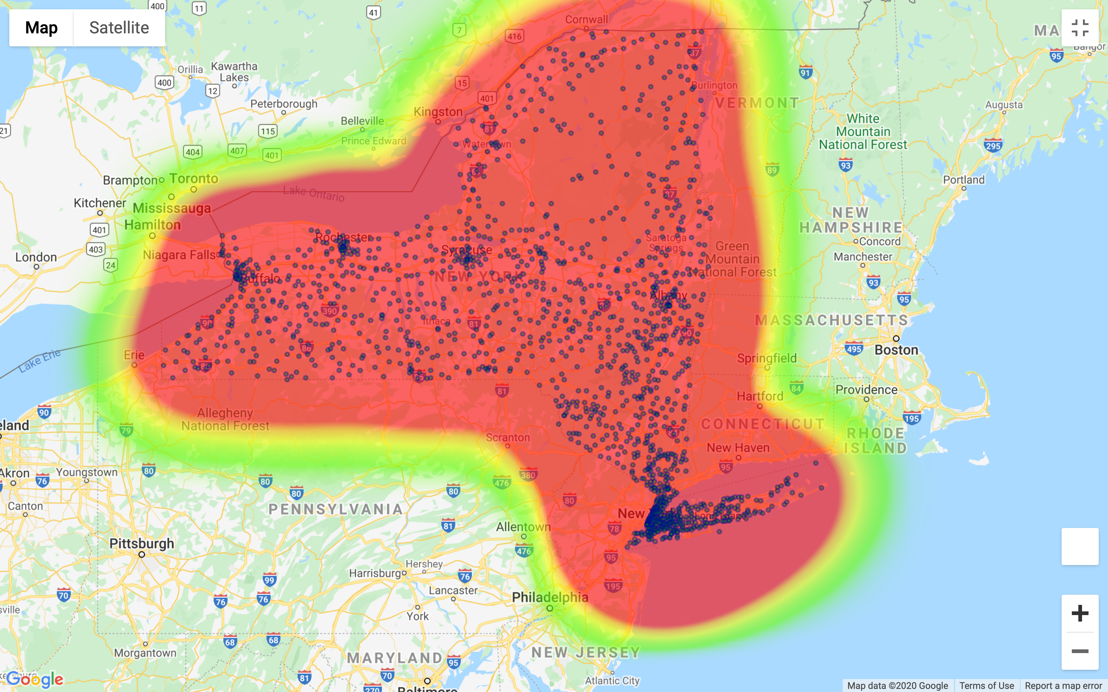
Distribution of ”Green” vehicles in relation to AQI 2020
Vehicle density of “Green” vehicles continues to be greatest in Urban areas vs. rural.
Ownership if “Green” vehicles appears to have little impact on AQI
AQI diminishes for some unknown factor.
Continued increase in number of total “Green” vehicles overall in the state.

Slide 26
Regulations
In 1993, NY adopted the Criteria Pollutant Regulation and ZEV program.
The Clean Air Act requires EPA to set National Ambient Air Quality Standards (NAAQS)HelpNational Ambient Air Quality StandardsNational Ambient Air Quality Standards established by EPA for six "criteria" pollutants in outdoor air. NAAQS are currently set for carbon monoxide, lead, ground-level ozone, nitrogen dioxide, particulate matter, and sulfur dioxide. for six common air pollutants (also known as "criteria air pollutants"). These pollutants are found all over the U.S. They can harm your health and the environment, and cause property damage.
The Zero Emission Vehicle (ZEV) program is a California state regulation that requires automakers to sell electric cars and trucks in California and 10 other states. The exact number of vehicles is linked to the automaker’s overall gasoline and diesel sales within the state.
https://www.epa.gov/criteria-air-pollutants
https://www.ucsusa.org/resources/what-zev

Slide 27
Regulations
In 2009, NY adopted GHG Regulation, national program for greenhouse gas emissions (GHG) and fuel economy standards for light-duty vehicles (passenger cars and trucks) was developed jointly by EPA and the National Highway Traffic Safety Administration (NHTSA).
https://www.epa.gov/regulations-emissions-vehicles-and-engines/regulations-greenhouse-gas-emissions-passenger-cars-and

Slide 28
Conclusion
There is no direct correlation between vehicles and air quality, therefore we reject the hypothesis.
The analysis shows
No direct correlation between the density of cars in a given area and the air quality index in that area.
No direct correlation between age of cars and air quality index in a given area.
No direct correlation between body type and air quality index
No direct correlation between hybrid/electric vehicles and air quality index

Slide 29

Observations
There was a decrease in Air Quality Index from 2009 to 2015 and an increase in Air quality Index from 2015 to 2020.
There are outside factors that affect the air quality in NY state other than vehicle emissions.
There was an increase in the percentage of electric/hybrid vehicles over the 3 years.
https://github.com/paloni-dotcom/Se7en

Slide 30

Questions?

